Slide 1
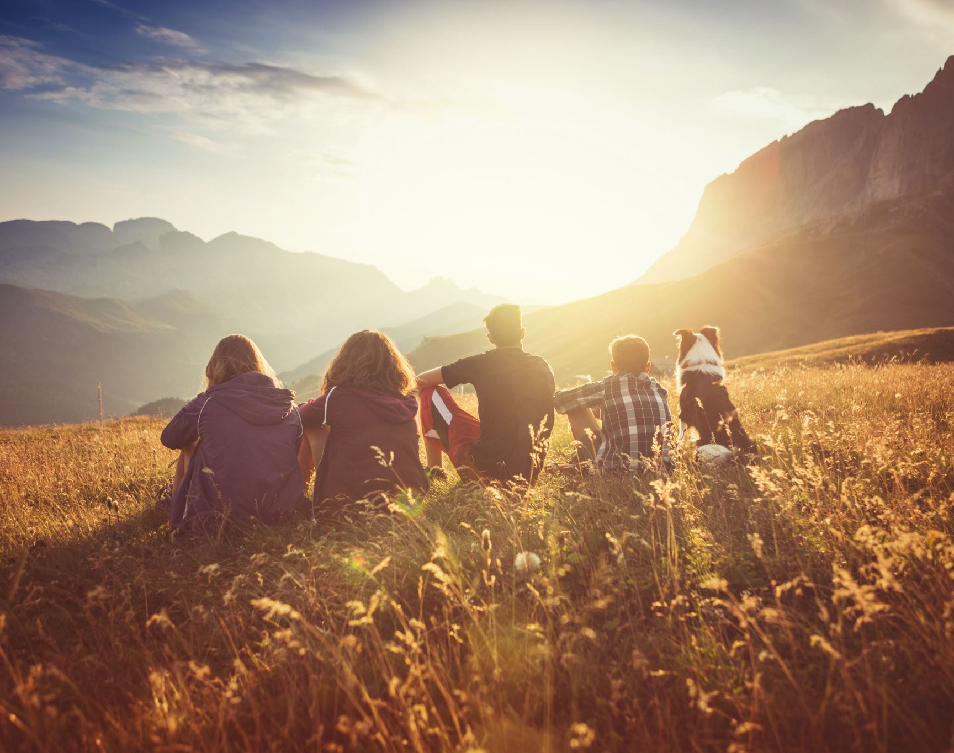
Setting up a Missional Community with Children and Young People
Jon & Julie Wetherell
Notes:
Welcome & Intro

Slide 2
So he came and proclaimed peace to you who were far off and peace to those who were near; for through him both of us have access in one Spirit to the Father. So then you are no longer strangers and aliens, but you are citizens with the saints and also members of the household of God, built upon the foundation of the apostles and prophets, with Christ Jesus himself as the cornerstone. In him the whole structure is joined together and grows into a holy temple in the Lord; in whom you also are built together spiritually into a dwelling-place for God.
Ephesians 2:17-22
Notes:
Jon to read

Slide 3

Dear Lord
We thank you for the opportunity to serve you in our communities and settings.
We pray today that you would help us to use this time wisely to learn about working together to see your Kingdom Come in Birmingham, Solihull and beyond.
May you be here and guide us by the power of your Holy Spirit as we seek to do Your will.
In Jesus name
Amen
Notes:
Jon to lead prayer for everyone – Anglican style where everyone joins in and says aloud

Slide 4
WHAT IS A MISSIONAL COMMUNITY?
The words ‘missional community’ describe a group of people committed to a task/mission and to each other.
Community begins in the Gospels where Jesus is with others in their lives. He helped his followers to see new possibilities, to see a greater potential in themselves, the community and the world.
Notes:
Jon

Slide 5

What might a Jesus-centred missional community look like?
A mixed bunch of people with the same missional purpose
Different Ages
Different Skill Sets
Different Experiences
A Community with a Desire for Christ-centred fellowship
A Community that shares at a deeper level
A Community that shares food together
Notes:
Julie

Slide 6
OUR STORY
Notes:
Julie

Slide 7
I believe God is still working in our world and I want to be part of this.
I want my life to be about mission and I know that mission isn’t someone else’s job – it’s mine.
I want to live for Jesus daily and I realise I need fuel for this journey
As a part of this missional community, I will aim to keep mission a priority
Notes:
(Jon to click during story)

Slide 8
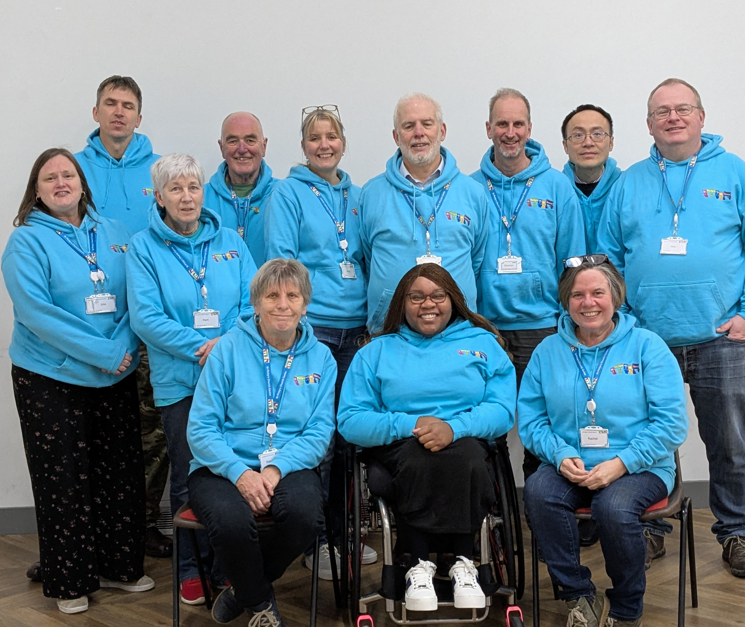
Our Youth Missional Community
Notes:
(Jon to Click during story)

Slide 9
Cultivating
Harvest
Sowing
Notes:
(Jon to click during story)

Slide 10
Let’s be realistic it’s not all plain sailing…..
Different personalities with different experiences and ideas working together
Ensuring we have the resources we need
Setting and agreeing rules and boundaries with the young people which everyone can work with
Mobile phones
Reliability
Sharing the workload
Notes:
Jon – Now you might be sitting there thinking, well it’s alright for you, you’ve got a wonderful new building, loads of money however….

Slide 11

So in your context… Where do you start:
What is on your heart to grow a missional community in your setting:
Prayer
Conversations
Meeting together
Is this in your church setting? – Do you need accountability/permission with your church leadership or PCC?
Is this a community setting? Where is the mission going to take place? Obviously, correct DBS’s and safeguarding must be in place. Who are you accountable to???
Ask and face the difficult questions as they come up.
Notes:
Jon

Slide 12

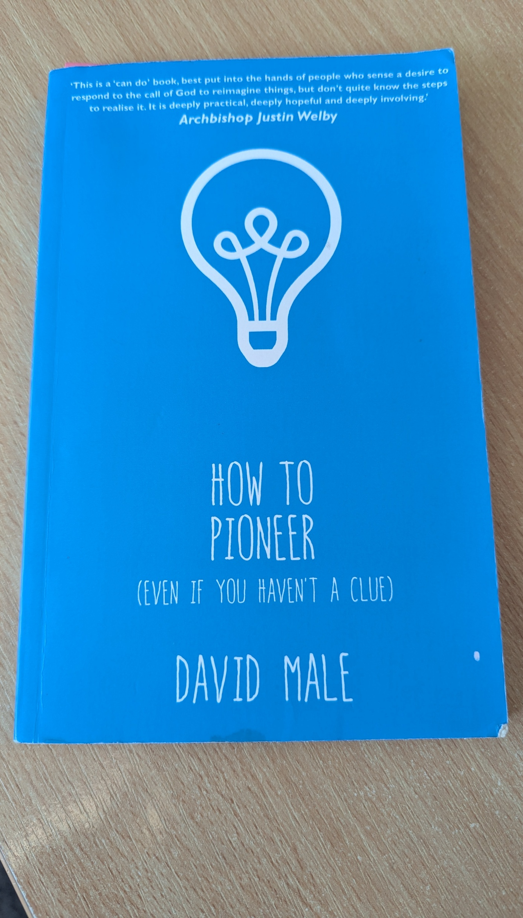
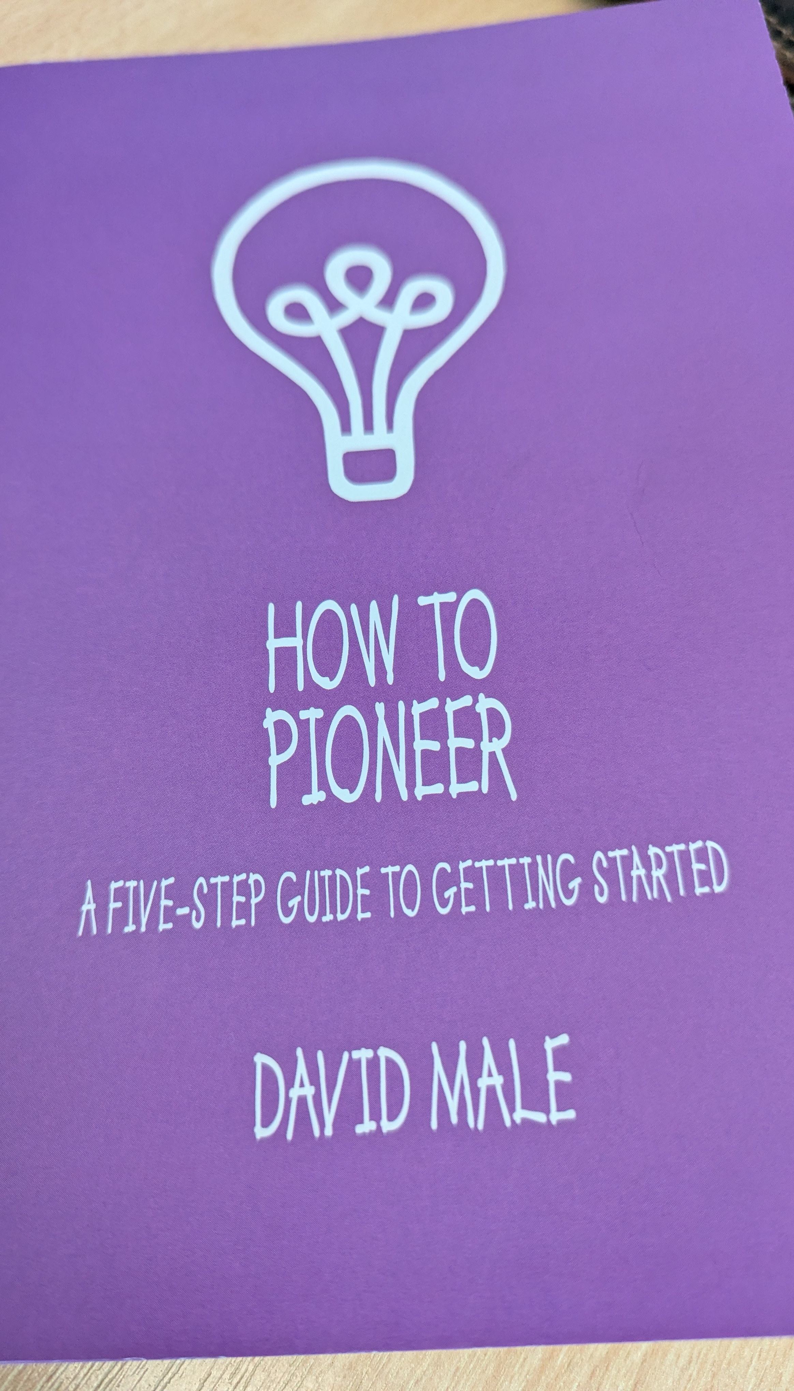
Recommended Reading
Notes:
Julie

Slide 13
Challenge….
If we are committed to serving, following and living for Christ why do we think in terms of rotas – we don’t decide to go to aerobics every other week, or watch our favourite programme once a month, yet we decide we can’t commit to share, teach or spare time with the children and young people in our communities and churches more than once every few weeks to bring them to Christ and disciple them ensuring changed lives forever. This is the most important thing we will ever do. I think we need to be challenged and stirred up in our mindsets as to how we consider living for Jesus and obeying His calling.
Notes:
Both

Slide 14

ANY QUESTIONS
Notes:
Both

