Slide 1

What have grandparents got to do with it?
Becky Sedgwick
Parenting for Faith
Notes:
Welcome!
. My name is Becky Sedgwick and I work for PFF, an organisation specialising in supporting churches as they support parents, carers and the wider family to disciple their kids and teens. And I wrote this book, Grandparenting for Faith.
Here to help you think about this more. To learn from each other – you have so much wisdom. Do get to know each other, share experiences and ideas - so valuable

Slide 2

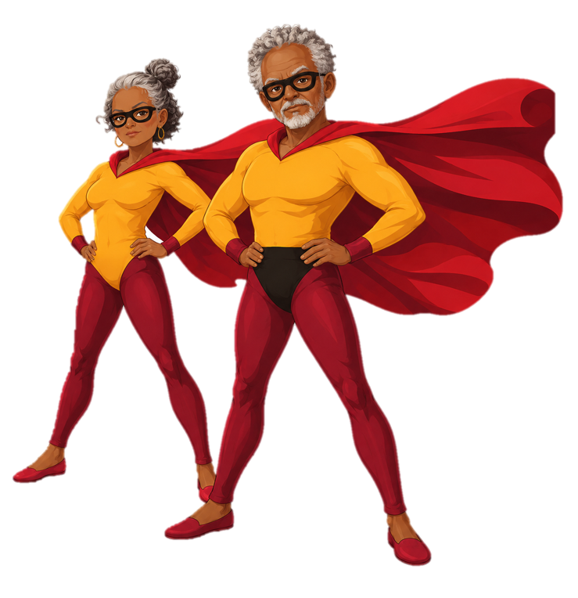
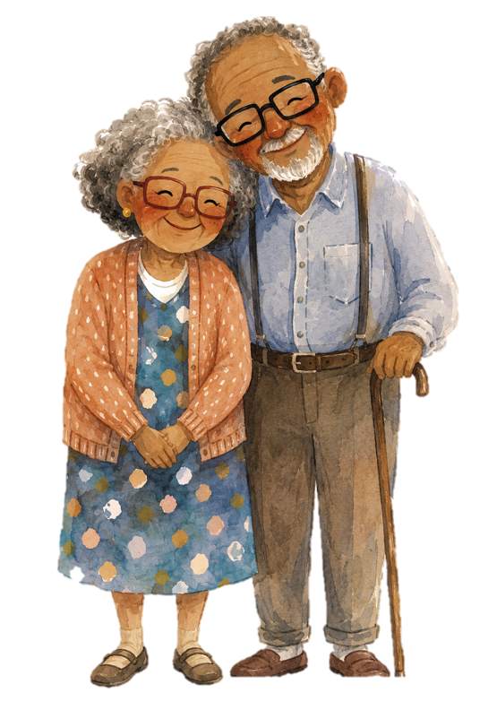
An untapped resource …
Notes:
What if I were to tell you that you had a huge untapped resource already in your church that has the potential to transform the impact of your kids / youth or family ministry?
Click – cute grandparents
No, not these … click – THESE!
It’s something I guarantee you’ve all got! The grandparent generation.

Slide 3
Your church
What are your hopes and dreams?
What are your frustrations?
What are your needs?
Notes:
Before we start unpacking why the grandparent generation is so exciting for your church and your work with children and young people and families – let’s just think for a mo about our churches -
shout out answers
What are your hopes and dreams for your kids / youth / family ministries
What are your frustrations?
What are your needs?
Now, I’m not saying the gp generation can meet all those needs, but I think they might just have something a bit special to offer.

Slide 4
Share with those around you
How many under 5s
How many 5s to 11s
How many 12s-18s
How many over 60s?
What do you notice?
Notes:
Feedback – what do you notice?
What if we were able to leverage the power of the grandparent generation? How might that change things?
Link to: we’re going to explore WHY we need to change that and HOW we can start to do that.

Slide 5
Why does involving the grandparent generation matter?
Notes:
Share ideas –
Take answers:
Bodies – we always need volunteers! Might have time during the day / less pressured diaries. But this generation offers far more than bodies.
They are important for healthy discipleship:
Discipleship is not primarily about good teaching but multiple people walking alongside you, showing you that God is relevant and powerful and helping you discover that for yourself. Conversations, role models, seeing how others interact with God, hearing stories. Not transfer of information but doing life together, learning from each other, observing, talking, sharing. ‘Alongsiders’.
God’s design for church was never silos (OT examples. All generations together, hearing, seeing, learning. Eg of Deut 31:12-13 and Neh 8:2. Age specific discipleship happened but in the family naturally. We learn from those around us. Mrs Summers. Who has influenced your faith journey – multiple people (KW, Rosemary, JT, team).
Sticky Faith – 5 interested Christian adults in your kids life makes a difference to their life long discipleship. Why? We learn more about God the more people we know who follow him. Psalm 78 QUOTE. Encouragement. Role models, different ways of communicating, different experiences.
When we have the next generations ahead of us, we learn how to do our next bit of life – perspective, marriage, life events, death (mum). Life group story.
When we help the grandparent generation engage with our children, young people and families we enrich their understanding of God. We give them more people to be interested in them, love them, know them, care about them. We give them more access to stories of God and ways of understanding faith. Eg mad about science. Contemplative. Challenging. Restless. We’re all different and need to see people like us following God.
Is that what you’re seeing in your church? Why not?

Slide 6
What are the barriers?
They’ve not been invited
They discount themselves
  Relevance / young person’s world / I’ve done my bit
Lack skills or confidence
Safeguarding concerns
Never thought about it
Notes:
What do you think some of the barriers might be for gp generation getting involved? Call out. Debunking in bold
How can we help them get over the barriers? Take ideas
- Not invited – invite them
- Discount themselves:
- I’m no longer relevant – I don’t understand that world – don’t need people who understand that world. What kids want is curiosity, relationship, consistency, presence
-It’s a young person’s business – problem of church culture focussing on cyf ministry? It isn’t! We need every generation. Not to be the same but to be what they are good at. Big picture of why God’s important at every stage. Understanding how God works in all of life.
I’ve done my bit (David L) – up to the next generation God never said that. Moses. Caleb. Psalmist – fruitful in old age. Ps 78 – tell stories to the generation and the generation to come
- Feel they lack skills / confidence – I can’t teach kids about God / deal with behaviour / run a game / never done it (men in particular?) We’re not going to ask you to do stuff you can’t, but rather do stuff you can do really well. And we can train and equip you for that. And start you small …
Safeguarding concerns reiterate and coach in normal safeguarding understanding and practice
- Never thought about it – we need to tell a different story in church!

Slide 7
Let’s tell Asaph’s story
I will utter hidden things, things from of old—
things we have heard and known,
things our ancestors have told us.
We will not hide them from their descendants;
we will tell the next generation
the praiseworthy deeds of the Lord,
his power, and the wonders he has done …
so the next generation would know them, even the children yet to be born, and they in turn would tell their children.
Then they would put their trust in God and would not forget his deeds but would keep his commands.
Notes:
This is the story we want to tell:
Older generation have stories to tell – not just the bible but their own stories of who God is and what he’s done (heard and known)
The next generation needs to know – so they know who they are putting their trust in.
What can they offer? SUMMARY OF WHAT WE’VE TALKED ABOUT
Wisdom and perspective
Stories of faith
Experience – just because of their longer lives. Births, deaths, moving, tragedy, questions, doubt, illness, challenges – stuff younger people need to work out with God

Slide 8
Starting to leverage the power of the grandparent generation
Change the mindset
  Talk about it in church
  Share stories of over 60s and kids
  Ask them to reflect on who influenced them
  Be ready to debunk the barriers
Notes:
Ideas for changing the mindset
Need to talk about this in church. Role of older generation. Why they have something unique to offer. God’s plan for cyf discipleship – includes others, not just formal teaching – examples, stories, encouragers, relationships – others on the journey
Share stories so people see it’s not about becoming something they’re not – eg of our recent junior church session – three over 60s sharing why they’re glad they’re a Christian … Benjy – so many miracles it was almost boring. Rosie and Fred – really bad illness, thought he’d die, ready to die, God sent someone with a different treatment – miracle. Rosie – the point she committed her life to God
Get them to reflect on who influenced them when they were young (how did your gps influence you – impact on older people)
Be ready to debunk the barriers

Slide 9
Starting to leverage the power of the grandparent generation
Invite them in
  Do it!
  Specific invites rather than general
  Invite in with a role
  Celebrate older volunteers
  Create natural opportunities for generations to mix
Notes:
Ideas for inviting in
Do it!
Specific invites not general. Not ‘help with holiday club’ but ‘someone to help with refreshments / be on the desk welcoming parents and carers. Not ‘become a junior church volunteer’ but ‘be a friendly face in the room in case any of the little ones need a bit of support’. Not ‘be part of Messy Church’ but ‘sit on a table at tea time to get to know people’.
Invite in occasionally with a role – bring an object that is significant for your journey of faith and tell the kids about it. Help us paint the youth room. Referee the game … whatever their strengths are
Celebrate older volunteers
In church, create natural opportunities for generations to mix – so they build natural relationships over time. Intergenerational interaction, not just presence

Slide 10
Starting to leverage the power of the grandparent generation
Play to their strengths
  Pete and Maggie
  Helen
  Gloria
  Francis
Notes:
Ideas for play to their strengths
Eg Pete and Maggie building an insect hotel at Messy Church
Helen – refreshments but also a listening ear
Gloria – cuddling babies and chatting to parents at toddlers
Francis – directing garden operations from a chair
As we involve the gp generation, we help people’s discipleship – more examples, more relatioonships, specific experience / wisdom …

Slide 11
Your next steps
What would I want to tell someone else about what I’ve learned today?
What would I like to change or do - how will I do that?
What are my next steps?
Notes:
Five minutes to think about your next steps

Slide 12

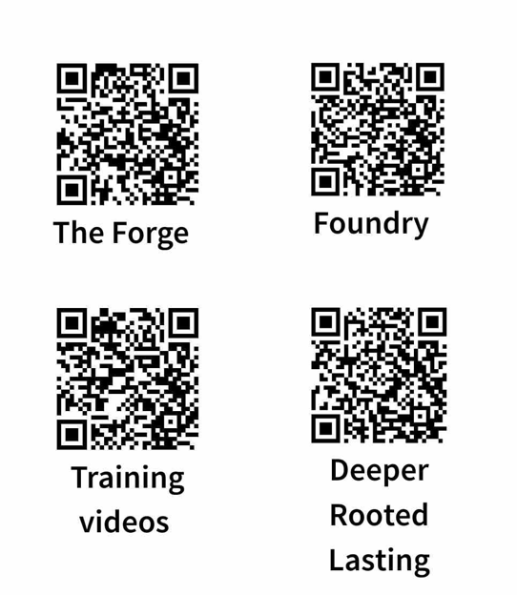
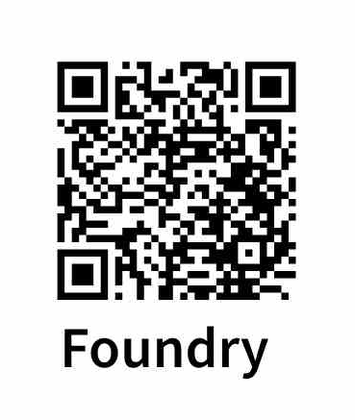
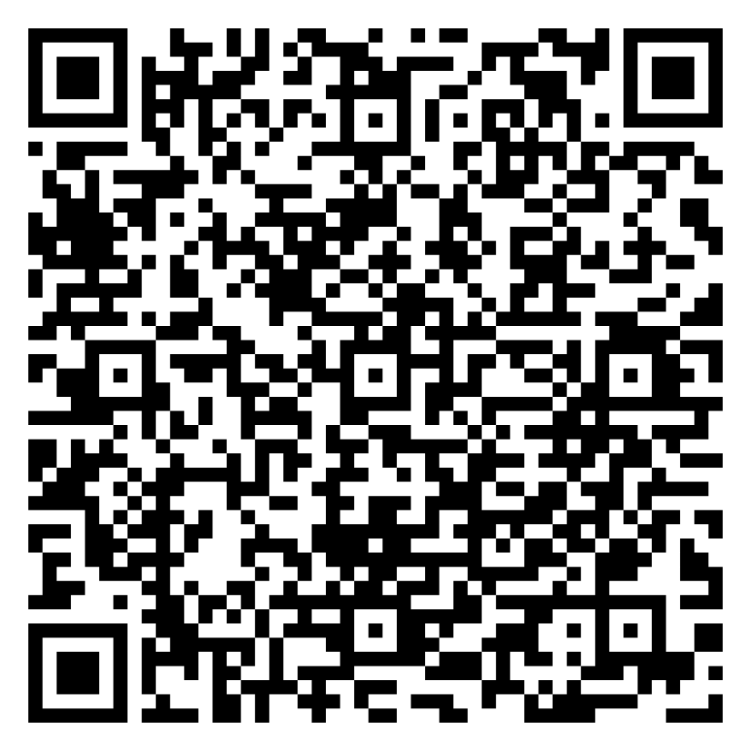
Keep in touch!
  Kate – kate.Irvine@brf.org.uk
Notes:
Five minutes to think about your next steps
Book and course – for the gp gen in your church, inspire, equip them
PFF not just for ps and cs – we’re here to support the churches who support ps and cs. Want to give you training, equipping, resources to help
Come and talk to us
Forge and Foundry
DRL – online self-paced video course asking – how can we equip and embrace parents and carers as they disciple their kids – even those on the fringes of church – what small tweaks can we make to existing groups, activities that change everything and help you see real fruit as parents and carers start to embrace their role, growing in confidence and skills to help their kids meet and know God
Courses on our new platform – free for two years for CoE churches

