Slide 1

Mentoring Young People

Slide 2

Content Page
Introductions
Hopes
Hall Green Youth Provision
What is Mentoring?
Case studies
Mentoring Programmes
Safeguarding
Collecting data
Questions
Our information

Slide 3
Introductions
Charity
Team
Church

Slide 4
Vision Statement
“Hall Green Youth is a Christian youth work charity dedicated to providing a safe, welcoming, and supportive spaces for young people. Through mentoring, journeying alongside, and building positive relationships, we aim to help young people grow in confidence and develop the skills they need to navigate life’s challenges. Our work focuses on supporting their emotional, social, and personal development, helping them to become happier, healthier, and more resilient individuals. By creating opportunities for connection, encouragement, and growth, we strive to equip young people with the tools and mindset they need to enjoy life and reach their full potential”

Slide 5
Hopes & Questions
Take this moment to write down any hopes or questions you want to gain from today’s session.
We will collect them and hopefully be able to answer as many questions as possible.

Slide 6
Our Work
Mentoring Programme:
Christ Church Secondary Academy
Mentoring Programme:
Wheelers Lane Technology College
Mentoring Programme:
Hall Green Secondary School
Youth Support Group:
Just Chill
Support Group:
16+ Group

Slide 7
Why Mentoring?
Covid 19 prevented us from running our lunch time and after school groups.
We learnt to adapt to the need in the current circumstance at the time.
We now offer both group work support and 1:1 support.

Slide 8
What is Mentoring?
“A voluntary, mutually beneficial and purposeful relationship in which an individual gives time to support another to enable them to make changes in their life.” – MBF
Mentoring is “offline help by one person to another in making significant transitions in knowledge, work or thinking.” – Clutterbuck, D and Megginson, D.
“Mentoring is to support and encourage people to manage their own learning in order that they may maximise their potential, develop their skills, improve their performance and become the person they want to be.” – Parasole, E.
Mentoring is a one-to-one, non-judgemental relationship in which an individual voluntarily gives time to support and encourage another. This relationship is typically developed at a time of transition in the mentee’s life, and lasts for a significant and sustained period of time,” – Home Office
“Mentoring is journeying with someone to help them overcome their present struggles” Boulton, L.

Slide 9
Origins of Mentoring
The Origins of mentoring is from an ancient Greek poem from Homer, of the story of Odyssey:
In the Odyssey, Mentor was the son of Alcimus. In his old age Mentor was a friend of Odysseus . When Odysseus left for the Trojan War, he placed Mentor in charge of his son Telemachus, and of Odysseus' palace. Odysseus returned after 20 years from war. Mentor guided Alcimus from an infant to a man.

Slide 10
  What is different about mentoring?
Counselling
Past: 20 + Sessions
CBT: 6-8 Sessions
Mentoring
Current: 12-15 sessions
Coaching
Future: 6 sessions

Slide 11
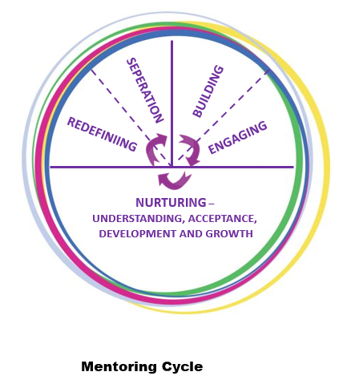
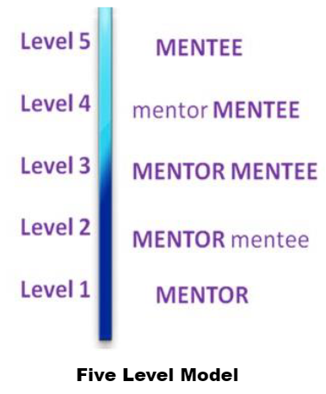
Framework

Slide 12
12 Week Programme
Mentoring students work better long term. However, working in schools there are restrictions, dictated by needs, finances and the school team.
We have a produced a 12 week session programme which fits within a school term.
We use this document loosely and as a guideline because every student is different.

Slide 13
Mentoring Programme
HGY Model:
Agreement with School (New one every year)
School based
Space
Resources
30-minute sessions
12 weeks programme for students (Can be negotiated)
Intervention for those who are not seen
Relationship with liaise
Safeguarding
Parental consent

Slide 14
The stuff that matters
YOU!
Be compassionate
Listen
Show up!
Be transparent
Be active in assessing their needs
Be honest
Hold them accountable
Be intentional

Slide 15
Referrals
Referrals protect us
Referrals give us key information
Referrals should indicate why the student is being offered mentoring
It’s crucial that parents and student are both aware of the referral
Referrals are your first point of collecting data.

Slide 16
Agreement
Mentor - Mentee
Agreements, promises or contracts – doesn’t matter what you call it. An agreement needs to be signed between a mentor and mentee.
Clear boundaries are written out, agreed, read and understood. (Allow the mentee to add to the list of rules)
Confidentiality:
If they share that they will harm themselves or someone else
If they share that they are going to commit a crime
If they want you to share information

Slide 17
Writing notes
Writing notes is for you, so you remember what you spoke about and agreed with that student.
Sharing notes with your liaise without breaking confidentiality,

Slide 18
Collecting Data
Outcome Tools:
We ask each student in every session three questions. Rate on a scale of 1-10, 1 = bad & 10 = Great.
How you felt before the session?
How you feel after the session?
Rate the support from your mentor?
Evaluations:
Once a mentoring relationship has ended, students will complete an evaluation form.
Student Reports:
Mentors will complete a report on each mentee after the mentoring relationship has ended.

Slide 19
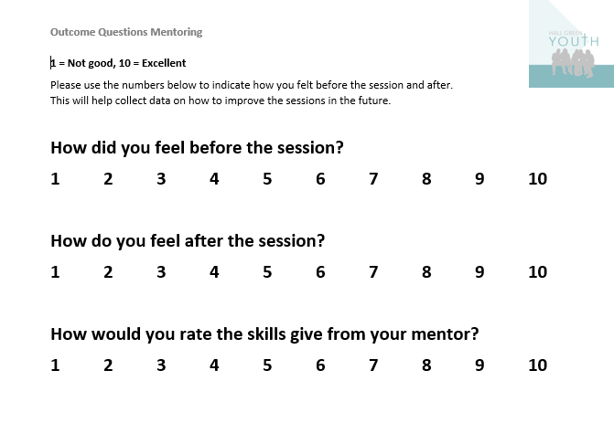

Slide 20
 | Student | Session Amount | How they felt before | How they felt after | Improvement from before to after | Rating the skills/advice from mentor | Comments
1 | DS | 24 | 7.5 | 9.5 | + 2 | 9.5 | EHCP & SEND
2 | KK | 13 | 7 | 9.3 | + 2.3 | 9.5 | S-ASD & SEND
3 | JM | 16 | 7.2 | 9.5 | + 2.3 | 9.5 | Family Conflict
4 | R | 11 | 8.3 | 9.7 | + 1.4 | 10 | Behaviour Issues & Family Conflict
5 | AA | 21 | 5.1 | 8.9 | + 3.8 | 10 | Behaviour Issues & Family Conflict
6 | MA | 16 | 5.8 | 9.5 | + 4.3 | 9.6 | S-ASD & Behaviour Issues
7 | MD | 6 | 9.3 | 10 | + 0.7 | 10 | Behaviour Issues
8 | AW | 6 | 6 | 9.8 | + 3.8 | 10 | Behaviour Issues & S-ASD
9 | AK | 13 | 8 | 9.3 | + 1.3 | 9.5 | Behaviour Issues & S-ASD
10 | FK | 6 | 7.8 | 9 | + 1.2 | 9.5 | Bullying & Behaviour Issues
11 | AA | 12 | 5 | 9 | + 4 | 9.1 | Bullying & Behaviour Issues
12 | HN | 11 | 8.3 | 9.7 | + 1.4 | 10 | S-ASD
13 | AH | 7 | 5.5 | 9.7 | + 4.2 | 10 | Behaviour Issues
14 | AH | 9 | 7.3 | 8 | + 0.7 | 9 | Not expressing struggles
15 | MH | 7 | 9 | 9.8 | + 0.8 | 10 | Behaviour Issues
16 | MS | 7 | 7.8 | 9.4 | + 1.6 | 9.6 | Struggling with school
17 | RF | 6 | 6.5 | 9.1 | + 2.6 | 10 | Previous CIN & S-ASD
18 | SI | 4 | 5.7 | 8.2 | + 2.5 | 8.7 | EHCP & SEND
19 | NS | 4 | 3.2 | 8 | + 4.8 | 8.5 | School difficulties
20 | I | 1 | 5 | 10 | + 5 | 10 | Left school after 1 session
 | Total | 200
 | Average | 10 | 5.9 | 9.2 | + 3.1 | 9.6

Slide 21
Mentors Report
Mentor: Mentee:
Number of Sessions:
What was the presenting issues/struggles/challenges? Originally stated (in referral) and anything that came up during your time mentoring. (Please bullet point).
What growth have you seen in the student? Were any goals/aims set and achieved?
What strategies/advice/support did you use to help the young person? (Please bullet point).
Have you identified any other areas this young person needs support? What advice can you give the school based on your time with this student?
Were there any barriers to mentoring this student?
Should this student continue having mentoring? Please answer yes or no and explain your answer.

Slide 22
Mentee: Year:
Mentor: Total Sessions:
On a scale of 1 – 10 (1 = not good & 10 = Great) Please circle.
How much have you enjoyed the time with your mentor?
1 2 3 4 5 6 7 8 9 10
How much has the mentoring impacted your well-being?
1 2 3 4 5 6 7 8 9 10
How much has the mentoring improved your school experience?
1 2 3 4 5 6 7 8 9 10
Would you like to continue in the future?
What would you change about the mentoring?
What have you enjoyed the most?
What have you learned about yourself or what areas have you grown?
Any further comments?

Slide 23

Ending the mentoring relationship
Ending any relationship can be difficult. Therefore, it is important to be clear that there will be an end to the relationship from the start. Being clear that there will be an end is a good boundary to have in place. It also helps to put a time limit, which can help when you are setting goals.
Ending a relationship doesn’t mean that the young person should stop accessing support. There are many services internal and external to school that can offer support to young people for a variety of issues/struggles.
Awareness
Empowerment
Signposting

Slide 24
Case Study
You have been given a referral; it’s a year 8 boy. Some behaviour issues in school. 1 of 10 children. Siblings in the school have behaviour issues. The family are always late to school.
During your sessions the student doesn’t engage much, gives one-word answers, never starts a conversation and just wants to play games.
What are your concerns?
How will you approach this young person?
What will you be aware off?
What happened and how did I work with this young person.

Slide 25
Case Study
You have been given a referral; it’s a year 7 girl. In her referral it shared that there has been some behaviour issues. The referral shares that the girl’s father passed away when she was 6 years old. The family moved to a new house one year ago and young person had to start a new school and make new friends in the area. During the sessions the student talks about her father but doesn’t mention that he has passed away.
What are your concerns?
How will you approach this young person?
What will you be aware off?
What happened and how did I work with this young person.

Slide 26
Question Time

Slide 27
Volunteering Opportunities
If you want to learn about mentoring and gain some experience, we could provide a volunteering opportunity. If you are interested, please get in touch.

Slide 28
Stay in contact
Emails:
Luke.Boulton@hallgreenyouth.co.uk
Katrina.Matthews@hallgreenyouth.co.uk
Work number:
07880 644 696
WhatsApp is our preferred method of communications
Website:
www.hallgreenyouth.co.uk

